Slide 1
This PowerPoint Presentation is ©2008 by Robin L. Simmons. All Rights Reserved.
Notes:
R=0, G=102, B=102

Slide 2
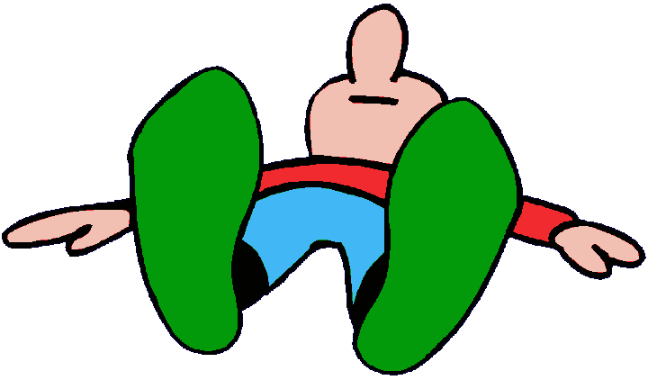
ENC 1101 – Lecture 2
Pronoun Agreement Until You Pass Out!

Slide 3
Rule 1: Know the general rule governing pronoun agreement.
A pronoun must agree with its antecedent.
The antecedent is the noun [or other pronoun] being replaced.

Slide 4
Here are two examples:
The lizard licked its eyeball.
Lizard = singular antecedent its = singular pronoun
The lizards licked their eyeballs.
Lizards = plural antecedent their = plural pronoun

Slide 5
Know the difference between these singular and plural pronouns.
Singular
He, she, it
Him, her, it
His, hers, its
Himself, herself, itself
Plural
They
Them
Their, theirs
Themselves

Slide 6
Do not confuse it’s with its.
It’s [with an apostrophe] means it is or it has.
Its [without an apostrophe] means belonging to it—for example, its bowl, its sharp teeth, its long claws, etc.
Possessive pronouns—unlike possessive nouns—do not need an apostrophe with the final s.

Slide 7
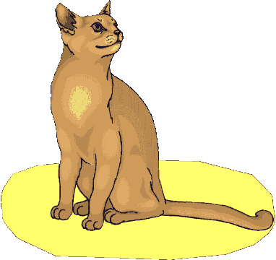
Rule 2, Part 1: The conjunction and can cause problems with pronoun agreement.
Two [or more] singular things joined by and become a plural antecedent.
The new puppy and kitten have destroyed their owner’s sofa.

Slide 8
Rule 2, Part 2: When each or every precedes two [or more] singular things joined by and, a singular antecedent is formed.
Each new puppy and kitten destroys its owner’s sofa.

Slide 9
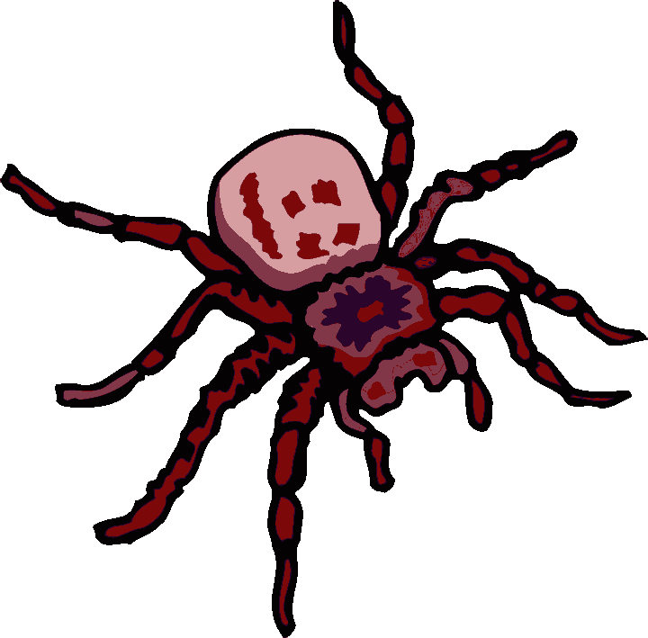
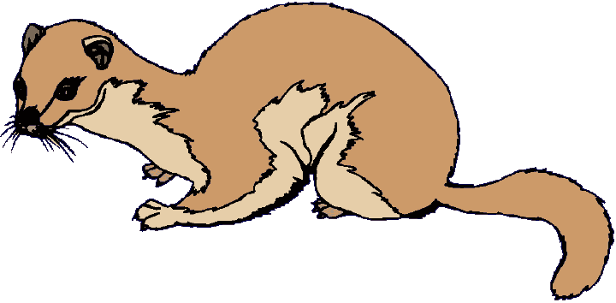
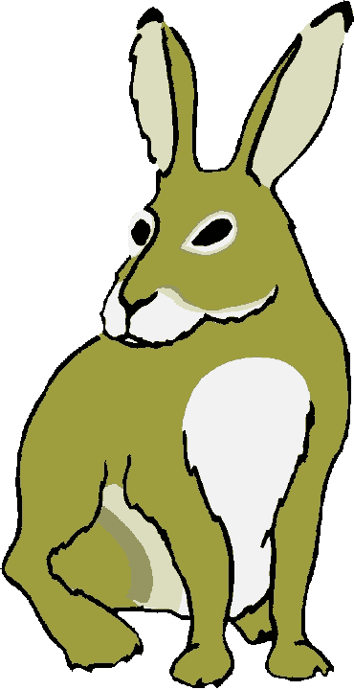
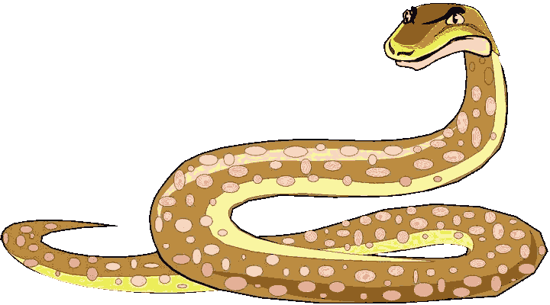
No matter how many singular nouns you join with and, the antecedent is still singular.
Each new puppy, kitten, rabbit, tarantula, python, parrot, iguana, and ferret destroys its owner’s sofa.

Slide 10
Rule 3: Use caution with these three conjunctions: either … or, neither … nor, and not only … but also.
Of the two antecedents in the sentence, the pronoun must agree with the closer one.

Slide 11
Here are two examples:
Not only Louise but also the Smiths fixed their famous squid eyeball stew for the picnic.
Not only the Smiths but also Louise fixed her famous squid eyeball stew for the picnic.
+
=

Slide 12
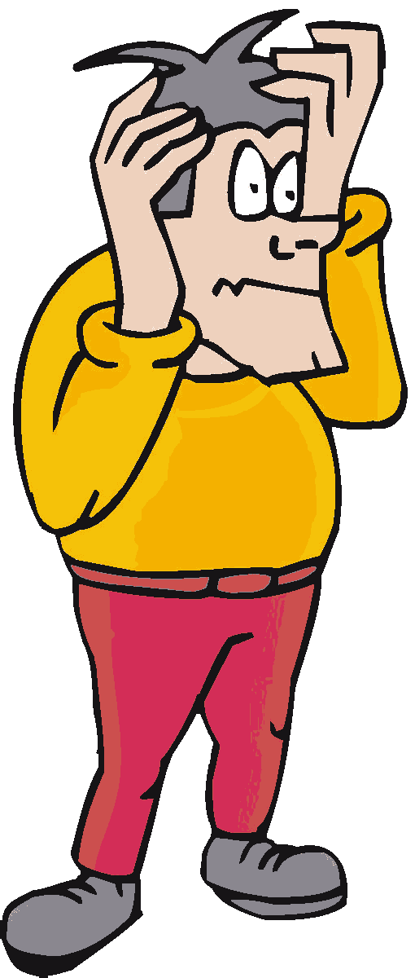
Indefinite pronouns cause the biggest headaches for pronoun agreement.

Slide 13
Rule 4, Part 1: These indefinite pronouns are always singular [even when they seem plural].
Each, either, neither
Anyone, anybody, anything
Everyone, everybody, everything
No one, nobody, nothing
Someone, somebody, something

Slide 14
Everyone on Earth = more than one person—billions of people, in fact. The word everyone, however, is still singular.

Slide 15
Read this example:
Neither of my two brothers show much sense when they date.
This sentence might sound right, but it is completely wrong!
Neither of my two brothers shows much sense when he dates. [Neither = singular.]

Slide 16
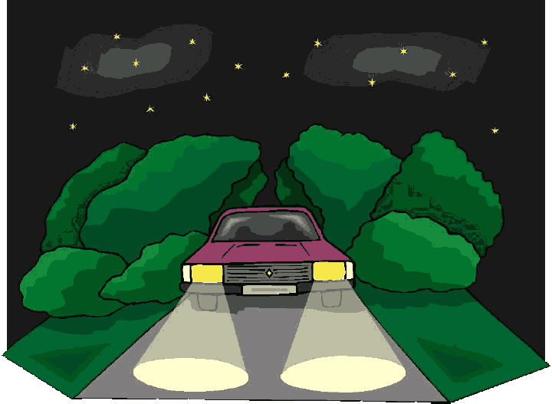
Now imagine a car like this one:

Slide 17
Rule 4, Part 2: When fixing an agreement error, try to avoid gender-biased language that might offend your readers.
The sentence below sounds natural but has an error.
Someone left their lights on.

Slide 18
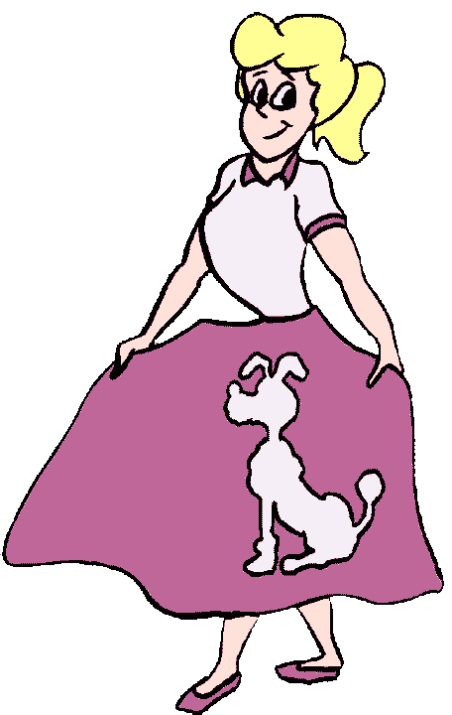
In the 1950s, rule books would have recommended using the masculine pronoun exclusively.
Oh, my! Someone left his lights on.

Slide 19
In the 1970s, after criticism from feminists, rule books next suggested using both genders so that males and females had equal representation in the language.
Someone left his or her lights on.

Slide 20
A writer who begins with he or she or him or her will need to be consistent throughout the paper. Look what happens …

Slide 21
Oh, the horror!
Wanda Wrighter ENC 1101 October 17, 2007 Essay 1
Student Success
If a student wants to improve his or her grades, he or she should walk himself or herself over to the tutoring center. There, he or she can request a tutor to help him or her with his or her homework. This preparation for his or her class will ensure that he or she is ready when taking his or her quizzes and exams. In addition, the tutor might have old work to share. This way, the student can find out himself/herself what to expect on the assignments for a specific instructor that might change his/her assignments rarely. Thus, the one thing that will insure the success of a student is that he or she gets a tutor to help him or her.

Slide 22
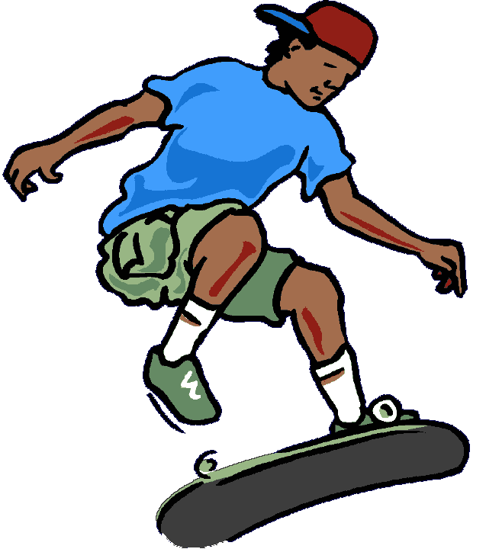
In the 21st century, fix the error without the annoying repetition.
There’s a car with its lights on.
Thankfully, my wheels don’t have that problem.

Slide 23
Rule 6: Companies, organizations, and schools are singular and thus require singular pronouns.
One urban legend is that McDonald’s makes its hamburgers with kangaroo meat.
The World Wildlife Fund uses the donations it receives to trample the rights of third-world people who share the habitat of endangered animals.
Next year, Valencia Community College will try to solve its parking woes by requiring students to buy a $75 parking decal.

Slide 24
Quick Test
Directions: Find and fix the errors.
1. At the zoo, every lion, tiger, leopard, bear, snake, and crocodile roared their approval when the mean child slipped in a puddle and cracked his head on the sidewalk.
its
their

Slide 25
Each of those worried students is wondering how to cheat effectively on their pronoun agreement quiz.
his
her
their
Or try this: Those worried students are wondering how to cheat effectively on their pronoun agreement quiz.

Slide 26
Both Mrs. Williams and her students are happy to hear that they can order squid eyeball stew for their lunch.
Correct!

Slide 27
Not only my two dogs but also Buster the cat loves to eat pepperoni that I pull off my pizza to give to them.
them.
him.
Remember that only the closer of the two antecedents counts: Not only Buster the cat but also my two dogs love to eat pepperoni that I pull off my pizza to give to them.

Slide 28
Oh, no! Someone left their greasy French fries on the essay that I have to turn in to Mrs. Neal next hour!
their
her
his
Or try this: Someone left greasy French fries on the paper that I have to turn in to Mrs. Neal next hour!

Slide 29
The class cheered their approval when Dr. Shuman postponed the frog dissection so that the students could go home early on Friday afternoon.
its
their
Or try this: The students cheered their approval when Dr. Shuman postponed the frog dissection…

Slide 30
Nick loves KFC, but they use so much MSG as flavoring that he sneezes for an hour after eating just a drumstick.
it uses
they use

Slide 31
Either of those two shirts will enhance your brown eyes with their vibrant colors.
its
their
Or try this: Both of those shirts will enhance your brown eyes with their vibrant colors.

Slide 32
The committee unanimously decided to impeach the president because they could no longer stand his long-winded speeches and unclear policies.
it
they
Or try this: The committee members unanimously decided to impeach the president because they could no longer stand …

Slide 33
The End.

